Slide 1
MOFs for Vehicle Hydrogen Storage Final Report
By Elias and Guido
Notes:
The subject Elias and I focused on for our final term paper was the use of Metal organic Frameworks as a Method to store hydrogen for vehicle applications.

Slide 2
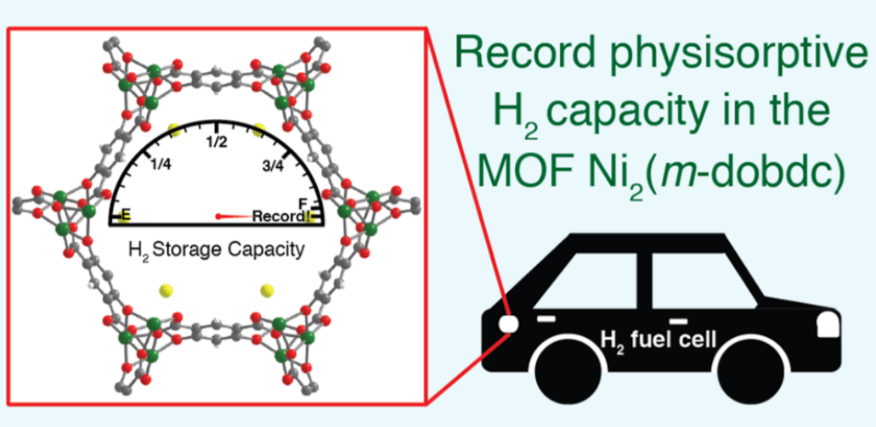
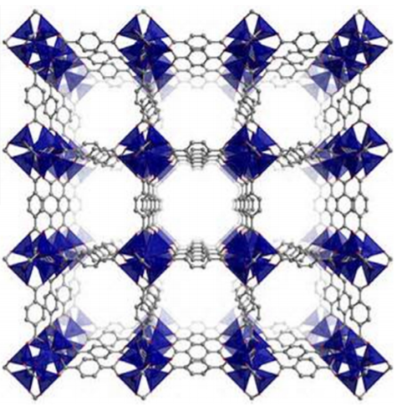
MOFs
Current best: Ni₂(m-dobdc) (Ni-MOF-74)
Highly porous
High tunability
Metals/Linkers
Reference 1
Reference (2)
Kapelewski, M. T.; Runčevski, T.; Tarver, J. D.; Jiang, H. Z. H.; Hurst, K. E.; Parilla, P. A.; Ayala, A.; Gennett, T.; FitzGerald, S. A.; Brown, C. M.; Long, J. R. Record High Hydrogen Storage Capacity in the Metal–Organic Framework Ni2(m-Dobdc) at Near-Ambient Temperatures. Chem. Mater. 2018, 30 (22), 8179–8189. https://doi.org/10.1021/acs.chemmater.8b03276.
(2) Gangu, K. K.; Maddila, S.; Mukkamala, S. B.; Jonnalagadda, S. B., A review on contemporary Metal–Organic Framework materials. Inorganica Chimica Acta 2016, 446, 61-74. https://doi.org/10.1016/j.ica.2016.02.062
Notes:
Before diving into the applications we explored for MOFs, we wanted to offer a very brief review on what metal organic frameworks are.
Basically, they are highly porous three-dimensional structures that can be made from various metal coordinates and organic linkers, which means that they offer high tunability for structure design.
In our case, we were looking at the physisorptive capacity of hydrogen that MOFs offer. In other words we were interested in the high surface to volume ratio the MOFs offer to store hydrogen in the structure cavities.
For our report, we decided to base our calculations from data on the current best MOF: the Ni-MOF-74, which showed the highest hydrogen capacity per volume.

Slide 3
MOF-FCEV Production phase
COST
Vehicle production
MOF-FCEV vs Compressed H2 FCEV vs Li ion BEV
Embodied energy
Power supply production
MOF fuel cell vs compressed hydrogen fuel cell vs Li ion battery pack
Notes:
The first application of MOFs we explored was its use as hydrogen storage for fuel cell vehicles.
To determine if its beneficial to build cars with this technology, we calculated the total cost of production of an electric vehicle with different power supplies. The power supplies in question were a fuel cell with an MOF storage system, a fuel cell with the common compressed hydrogen at 700 bar storage system, and a lithium-ion battery pack.
We also wanted to look at the energetic impact the MOFs would have in the production of the power supply to see if it was energetically favorable to replace the compressed hydrogen and lithium-ion battery power supplies.

Slide 4
Production phase: methods
Cost
Mg₂(dobdc) -> Mg₂(m-dobdc)
Factor: 0.75 for Liquid assisted grinding
factor: 0.55 for Solvothermal
Applied to Ni₂(dobdc) -> Ni₂(m-dobdc)
Embodied Energy
Correlated exergy from Ni-MOF-74 to LiCoO2
- similar synthesis methods
Notes:
To calculate the total cost of production for a fuel cell electric vehicle with our specific Nickel MOF-74 as storage, we had to estimate the cost per kilogram of the MOF production by calculating a factor from a similar MOF (the magnesium MOF-74).
We related the change in cost to the change in organic linker used and applied that factor to the available literature cost of our MOF to obtain the cost of production with the correct organic linker.
There was data available for two different synthesis methods of the MOF, so we calculated total costs for both synthesis methods as well
To those values we then added the production costs of a Proton exchange membrane fuel cell system, as well as costs for other car components and percentage mark-ups to estimate the total production cost of a vehicle.
For the compressed hydrogen vehicle we also assumed a Proton exchange membrane fuel cell and the same costs for other vehicle parts and mark ups, whereas for the lithium battery electric vehicles the cost was available from literature.
To calculate the embodied energy of the production phase for our MOF fuel cell electric vehicle, we focused solely on the embodied energy in the production of the power supply, which we defined as the hydrogen storage method and fuel cell used for hydrogen electric vehicles and as the lithium-ion battery pack for battery electric vehicles
To find the embodied energy of our specific MOF, we wanted to correlate the exergy values from both our MOF and the Lithium cobalt oxide we assumed was used in the battery to obtain a factor which we could apply to the literature value of embodied energy for lithium cobalt oxide and obtain the

Slide 5
Lower Production cost
Synthesis dependent
Notes:
After rigorous calculations, our cost results are very promising.
We see from our chart that the total cost of production for MOF fuel cell vehicles are lower than that for lithium-ion batteries. However, there’s still some ground to cover to compete with the compressed hydrogen fuel cell. It basically comes down to the total weight of the MOF needed and the synthesis method used for the MOF production.
As we see in the cost breakdown for the two MOF fuel cells with different MOF synthesis methods, there’s an approximate 10 thousand dollar difference and this is due to the heavy use of expensive organic solvents for the solvothermal synthesis. What this means for MOF hydrogen storage is that if an even greater MOF for hydrogen storage is developed and can be synthesized by liquid assisted grinding, the cost of total fuel cell vehicle could drop lower than the standard compressed hydrogen and offer an alternative technology to hydrogen electric vehicles.

Slide 6
Exergy estimated
Notes:
As for the embodied energy calculations, our exergy calculations were not ideal for estimation. It turns out that the total embodied energy for production we estimated for our MOF by exergy is 100 times greater than the literature value for a general MOF production. This exaggerated value resulted in absurdly big embodied energy total of MOF fuel cell production.
Since we couldn’t compare other technologies to a fuel cell with our specific Nickel MOF-74, we at least did the calculation for total embodied energy of production with the literature values for the general MOF production. As seen by the chart, the results also show MOF fuel cell as a promising alternative power supply for electric vehicles since the embodied energy is lower than that for lithium-ion batteries.
We also see from the pie chart that the percentage contribution to the total embodied energy from MOF material is quite high at 30%, which much like in the production cost results demonstrates that developing an MOF with higher hydrogen storage capacity would reduce the amount required for production and lower the total embodied energy even more, again offering a path for fuel cell vehicle technology which could compare to the established compressed hydrogen fuel cell vehicles.

Slide 7
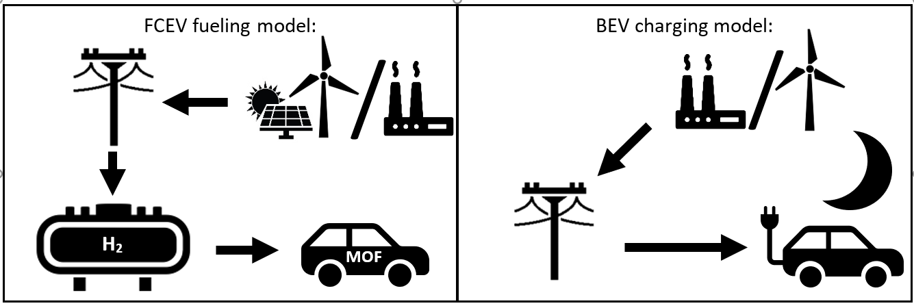
Notes:
Some of you may be thinking: who cares about storing H2
Electrolysis/Fuel cells have lower cycle efficiency than batteries BUT
BEV charging draws energy at time of demand (usually night), H2 electrolysis can use electricity whenever renewables are at peak capacity
Role of MOFs: less compression needed (100 vs 350-700 bar) -> intermediate storage is easier/no additional compression is needed before fueling

Slide 8
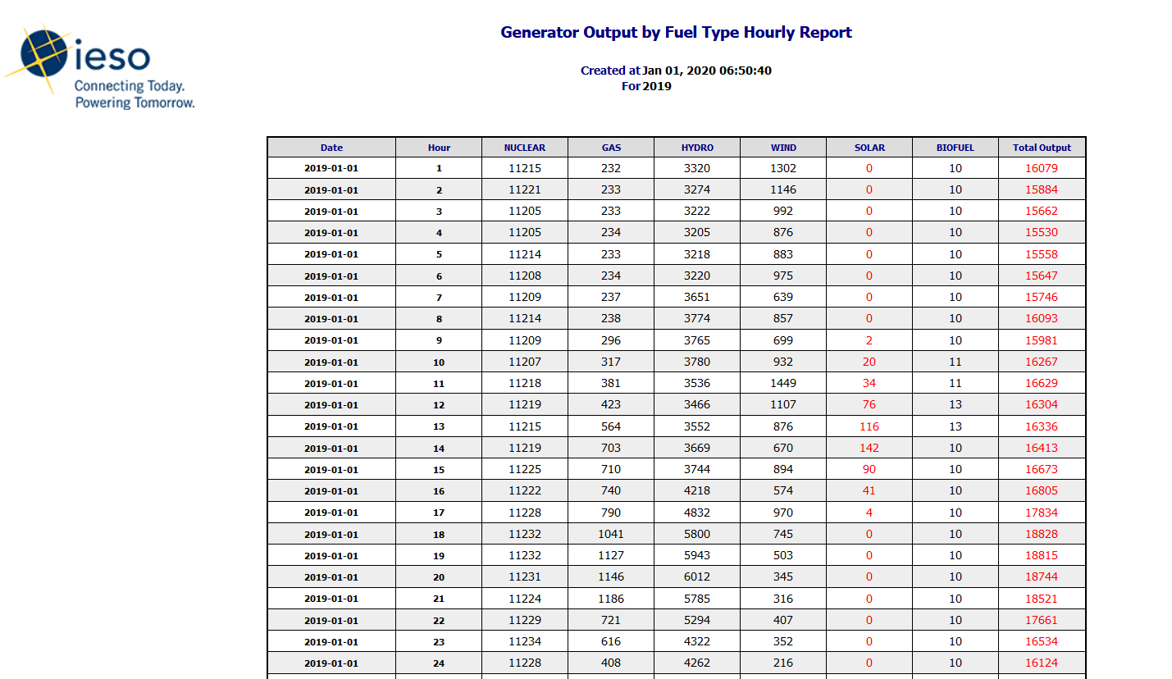
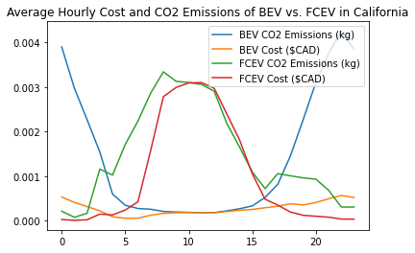
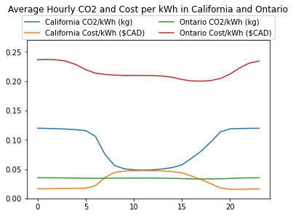
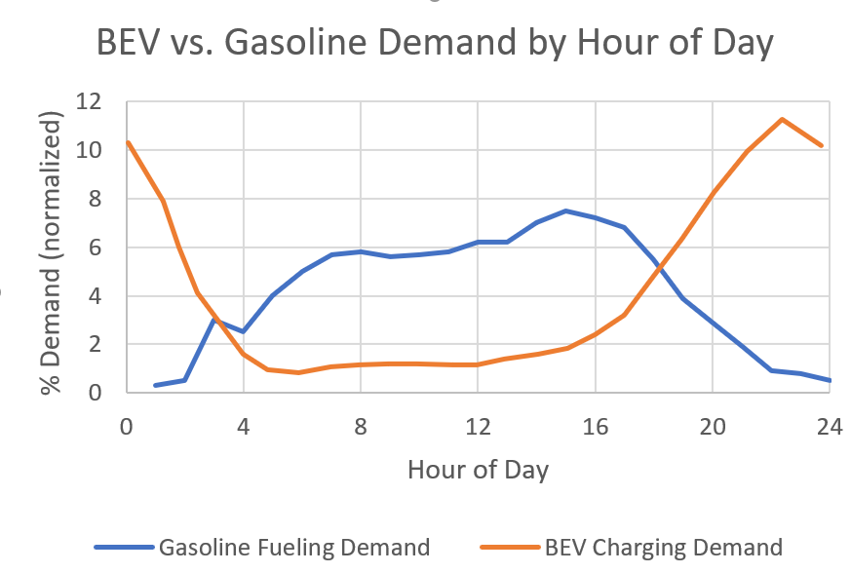
Hourly Demand
Notes:
Looked at California (lots of solar) and Ontario (more balanced, lots of hydro)
Calculated co2/cost per kwh (weighed avg of all sources)
Looked at demand over time of battery charging vs gas (H2 cars have quick refill)
Day-to-day variation means hourly averages lose information (wind energy or cloudy day) -> ran model through entire year of 2019 hour by hour

Slide 9
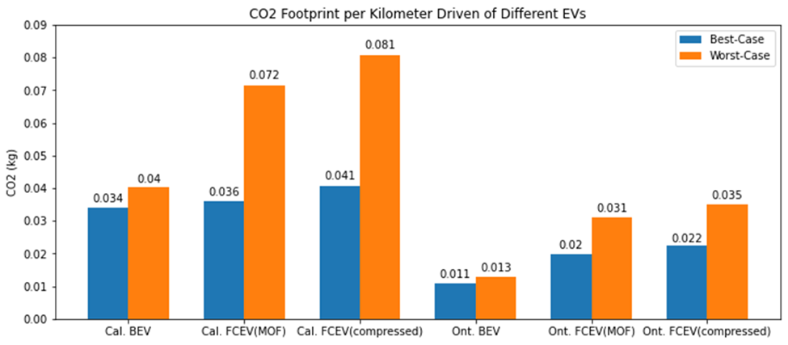
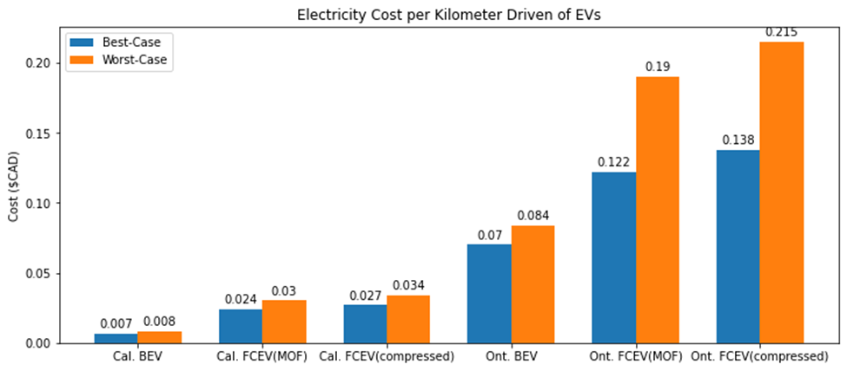
Use Phase
Comparable CO2 to BEV in California
Break even around 960,000-740,000 km (California) or 310,000 - 150,000 km (Ontario)
Limitations:
Not accounting for MOF + fuel cell being lighter/smaller than batteries
Solar values in infopack are outdated (said McCalla himself)
Notes:
Lighter/smaller: 200 vs 1000 kg, 0.2 vs 1 m^3
Take-home message: MOF-FCEVs may be comparable to BEVs already on a grid with renewables but little energy storage, with more material development they may be able to compete

Slide 10
Discussion
Thank you for your attention.

Slide 11
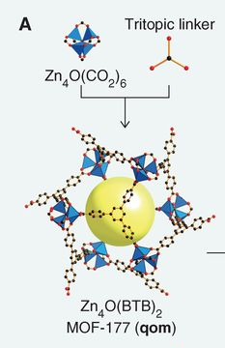
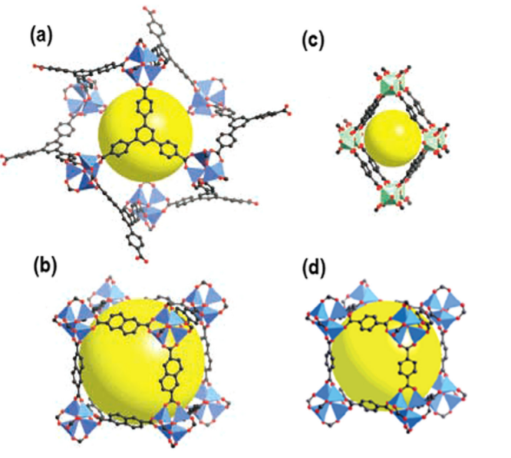

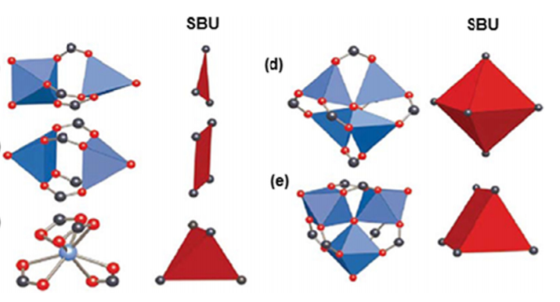
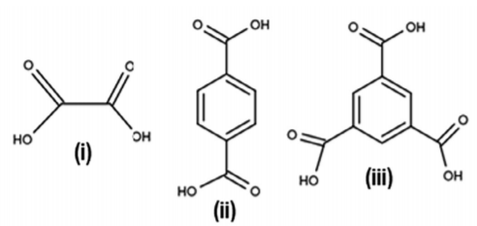
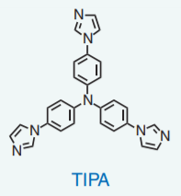
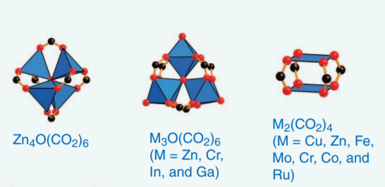
Metal-Organic Frameworks
Reference (2)
Reference (1)
Reference (1)
Reference (2)
Structure variation
Reference (1)
Reference (2)
High porosity
Reference (2)
Reference (1)
Reference (2)
Images from (1) Furukawa, H.; Cordova, K. E.; O’Keeffe, M.; Yaghi, O. M. The Chemistry and Applications of Metal-Organic Frameworks. Science 2013, 341 (6149). https://doi.org/10.1126/science.1230444.
(2) Gangu, K. K.; Maddila, S.; Mukkamala, S. B.; Jonnalagadda, S. B., A review on contemporary Metal–Organic Framework materials. Inorganica Chimica Acta 2016, 446, 61-74. https://doi.org/10.1016/j.ica.2016.02.062
Notes:
GUIDO
MOFs are Metal organic frameworks. They are a highly structured material which are made from metal ions and polytopic organic linkers as the name suggests. Here we can see some examples of MOFs structures where the yellow spheres represent the cavities where guest molecules can reside.
It’s hard to classify MOFs simply by which metals and organic linkers are used, so it is very common to use the concept of Secondary Building Units (or SBUs).
SBUs are the structures of the different metal or metal oxides coordination geometries. Here we see some examples of potential different SBUs which are characterized by the shape of the linking sites. Its these SBUs that are linked through polytopic organic linkers to make the MOFs.
The organic linkers used in MOFs offer a range of possible structures due to versatile coordination modes and their stability. The ligands are typically multidentate O-donor ligands like aromatic carboxylates, Nitrogen containing carboxylates and Azoles.
Here’s an example of MOF structure variation by using ditopic and tritopic linkers with the same SBU. On the left we see a cubic MOF due to the ditopic linkers whereas on the right, we see the structure changed by using the tritopic linkers.
The ligands chosen also have an important role in the overall structure as the non-covalent bonds they form between each other allows the formation of high dimensionality networks
Its these resulting networks which are appealing for research.

Slide 12
Hydrogen Storage
Produce H₂ on-site by electrolysis during peak renewables capacity
Store H₂ on-site at low pressure
Fill into vehicle MOF tanks during peak demand
Mazloomi, K.; Gomes, C. Hydrogen as an Energy Carrier: Prospects and Challenges. Renewable and Sustainable Energy Reviews 2012, 3024–3033. https://doi.org/10.1016/j.rser.2012.02.028.
(2) L7-information-pack - Fall 2020 - CHEM-429-001 - Chem of Energy, Storage & Util https://mycourses2.mcgill.ca/d2l/le/content/462835/viewContent/5227868/View (accessed Oct 11, 2020).
Notes:
ELIAS
Better specific energy + energy density than batteries BUT worse energy efficiency -> why is it relevant? Show H2 economy
Hydrogen strong suit: long range (gets lighter as you use it, unlike battery)

Slide 13
MOFs for H₂ Storage
H₂ Gas
MJ/L ↑
H₂ Adsorbed at Surface
High surface to volume ratio (1600 to 2200 m² cm⁻³)¹
Low overall density (0.3 to 0.6 g cm⁻³)¹
Thermal stability
Tunable for ideal adsorption/desorption²
H₂ in Ideal MOF
(1) Ahmed, A.; Seth, S.; Purewal, J.; Wong-Foy, A. G.; Veenstra, M.; Matzger, A. J.; Siegel, D. J. Exceptional Hydrogen Storage Achieved by Screening Nearly Half a Million Metal-Organic Frameworks. Nature Communications 2019, 10 (1), 1568. https://doi.org/10.1038/s41467-019-09365-w.
(2) Kapelewski, M. T.; Runčevski, T.; Tarver, J. D.; Jiang, H. Z. H.; Hurst, K. E.; Parilla, P. A.; Ayala, A.; Gennett, T.; FitzGerald, S. A.; Brown, C. M.; Long, J. R. Record High Hydrogen Storage Capacity in the Metal–Organic Framework Ni2(m-Dobdc) at Near-Ambient Temperatures. Chem. Mater. 2018, 30 (22), 8179–8189. https://doi.org/10.1021/acs.chemmater.8b03276.
Notes:
ELIAS
Hydrogen has amazing specific energy
would make ideal fuel for vehicles if we could bring the volume/energy down WITHOUT:
Using too much energy (cryo (20K)/compressed)
Adding too much weight
Using expensive/rare/difficult to synthesize material
Very high surface to volume ratio
Highly tunable
Rigid. and they have structural flexibility and thermal stability(source)
Storage at condense state better than compressed gas and liquid (source)
Adsorption/release easy due to porous nature interacting with gas with VDW(check citation)

Slide 14
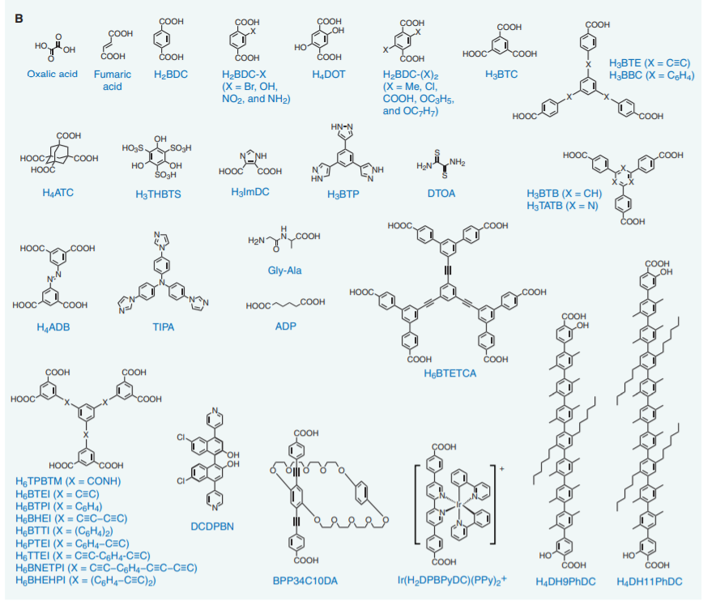
Problems and Research
Problems and Research
Problems and Research
Reference (1)
DOE numbers met at 77K & high pressures³
Moisture/scale-up problems ³
Ligands/SBUs
Structure ²
Hydrogen Interactions ^{2,3}
Purity
Activation Process³
Post-Treatment ³
Doping ³
Reference (2)
Reference (2)
(1) Furukawa, H.; Cordova, K. E.; O’Keeffe, M.; Yaghi, O. M. The Chemistry and Applications of Metal-Organic Frameworks. Science 2013, 341 (6149). https://doi.org/10.1126/science.1230444.
(2) Gangu, K. K.; Maddila, S.; Mukkamala, S. B.; Jonnalagadda, S. B., A review on contemporary Metal–Organic Framework materials. Inorganica Chimica Acta 2016, 446, 61-74. https://doi.org/10.1016/j.ica.2016.02.062
(3) Gangu, K. K.; Maddila, S.; Mukkamala, S. B.; Jonnalagadda, S. B., Characteristics of MOF, MWCNT and graphene containing materials for hydrogen storage: A review. Journal of Energy Chemistry 2019, 30, 132-144. https://doi.org/10.1016/j.jechem.2018.04.012
Notes:
GUIDO
Although MOFs are very promising, they have a long way to go for vehicle applications.
The United States Department of Energy (DOE) has set some targets for MOF hydrogen storage and Current MOFs can efficiently those targets, but only at cryogenic temperatures (77K) and high pressures, which are not desired conditions for vehicle applications.
Current MOFs also exhibit moisture instability and have scale-up difficulties. (often due to the materials used and the synthesis method employed)
Research is therefore focused on factors which influence hydrogen storage at ambient temperatures and pressures.
The ligands and SBUs are obvious factors as they define the structure, and they can also influence hydrogen adsorption based on their different interactions with hydrogen. (pi stacking, van der waals, hydrogen bonding)
Attention has also been turned to other factors, such as Purity of the MOFs because presence of impurities reduces the surface area available for hydrogen. Post treatment procedures can also influence the stability and surface area of MOFs
Other research has explored doping MOFs with other metals or structures to improve hydrogen storage, such as adding Multi Wire Carbon nanotubes or platinum, and other research showed that adding carbon black reduces moisture instability.

Slide 15
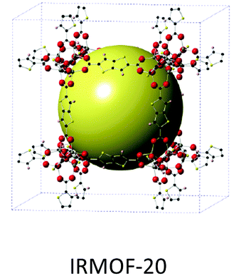
Best Current MOF for H₂ Storage
(1) Ahmed, A.; Liu, Y.; Purewal, J.; Tran, L. D.; Wong-Foy, A. G.; Veenstra, M.; Matzger, A. J.; Siegel, D. J. Balancing Gravimetric and Volumetric Hydrogen Density in MOFs. Energy Environ. Sci. 2017, 10 (11), 2459–2471. https://doi.org/10.1039/C7EE02477K.
(2) Ahmed, A.; Seth, S.; Purewal, J.; Wong-Foy, A. G.; Veenstra, M.; Matzger, A. J.; Siegel, D. J. Exceptional Hydrogen Storage Achieved by Screening Nearly Half a Million Metal-Organic Frameworks. Nature Communications 2019, 10 (1), 1568. https://doi.org/10.1038/s41467-019-09365-w.
Notes:
ELIAS
usable H₂ capacity of 5.7 wt% and & 33.4 g/L (77 K, pressure swing 5 - 100 bar)
Ceiling: current H2 storage MOFs are all previously reported, not designed explicitly for H2 storage

Slide 16
Project future
Explore using MOFs as H₂ storage for FCEV
MOF Research/Reviews to vehicle application
Eco-audit of:
Current best “realistic” MOF
Hypothetical best MOF
Larger role of vehicle MOFs in hydrogen economy
Understand screening and selection process for promising MOFs
Notes:
For the future of the project we want to more accurately explore the idea of MOFs for hydrogen storage in fuel cell electric vehicles.
This will require us to read research papers and reviews specifically about applying MOFs as a vehicle fuel since we mostly just researched the science of MOFs so far
We will also conduct an eco-audit of both the current realistic and hypothetical best MOFs
To help us with the eco audit we also want to explore the bigger picture of the hydrogen economy and read about different variables which could affect the feasibility of using MOFs to store hydrogen for vehicles
We also want to have a better understanding of what procedures researcher are taking or would need to take in order to determine the best possible MOFs for such a task, since most papers seem to be blindly exploring different MOFs.

Slide 17
Best Current MOFs for H₂ Storage
Experimental: IRMOF-20
Zinc-based ( Zn₄O(C₈H₂O₄S₂)₃ )
usable H₂ capacity of 5.7 wt% and & 33.4 g/L (77 K, pressure swing 5 - 100 bar)¹
Computational: ECOLEP
Cobalt-based
39 g-H₂ L⁻¹ & 8.2 wt.%
Ceiling at 40g/L ? ²
(1) Ahmed, A.; Liu, Y.; Purewal, J.; Tran, L. D.; Wong-Foy, A. G.; Veenstra, M.; Matzger, A. J.; Siegel, D. J. Balancing Gravimetric and Volumetric Hydrogen Density in MOFs. Energy Environ. Sci. 2017, 10 (11), 2459–2471. https://doi.org/10.1039/C7EE02477K.
(2) Ahmed, A.; Seth, S.; Purewal, J.; Wong-Foy, A. G.; Veenstra, M.; Matzger, A. J.; Siegel, D. J. Exceptional Hydrogen Storage Achieved by Screening Nearly Half a Million Metal-Organic Frameworks. Nature Communications 2019, 10 (1), 1568. https://doi.org/10.1038/s41467-019-09365-w.
Notes:
ELIAS
Ceiling: current H2 storage MOFs are all previously reported, not designed explicitly for H2 storage

